Slide 1
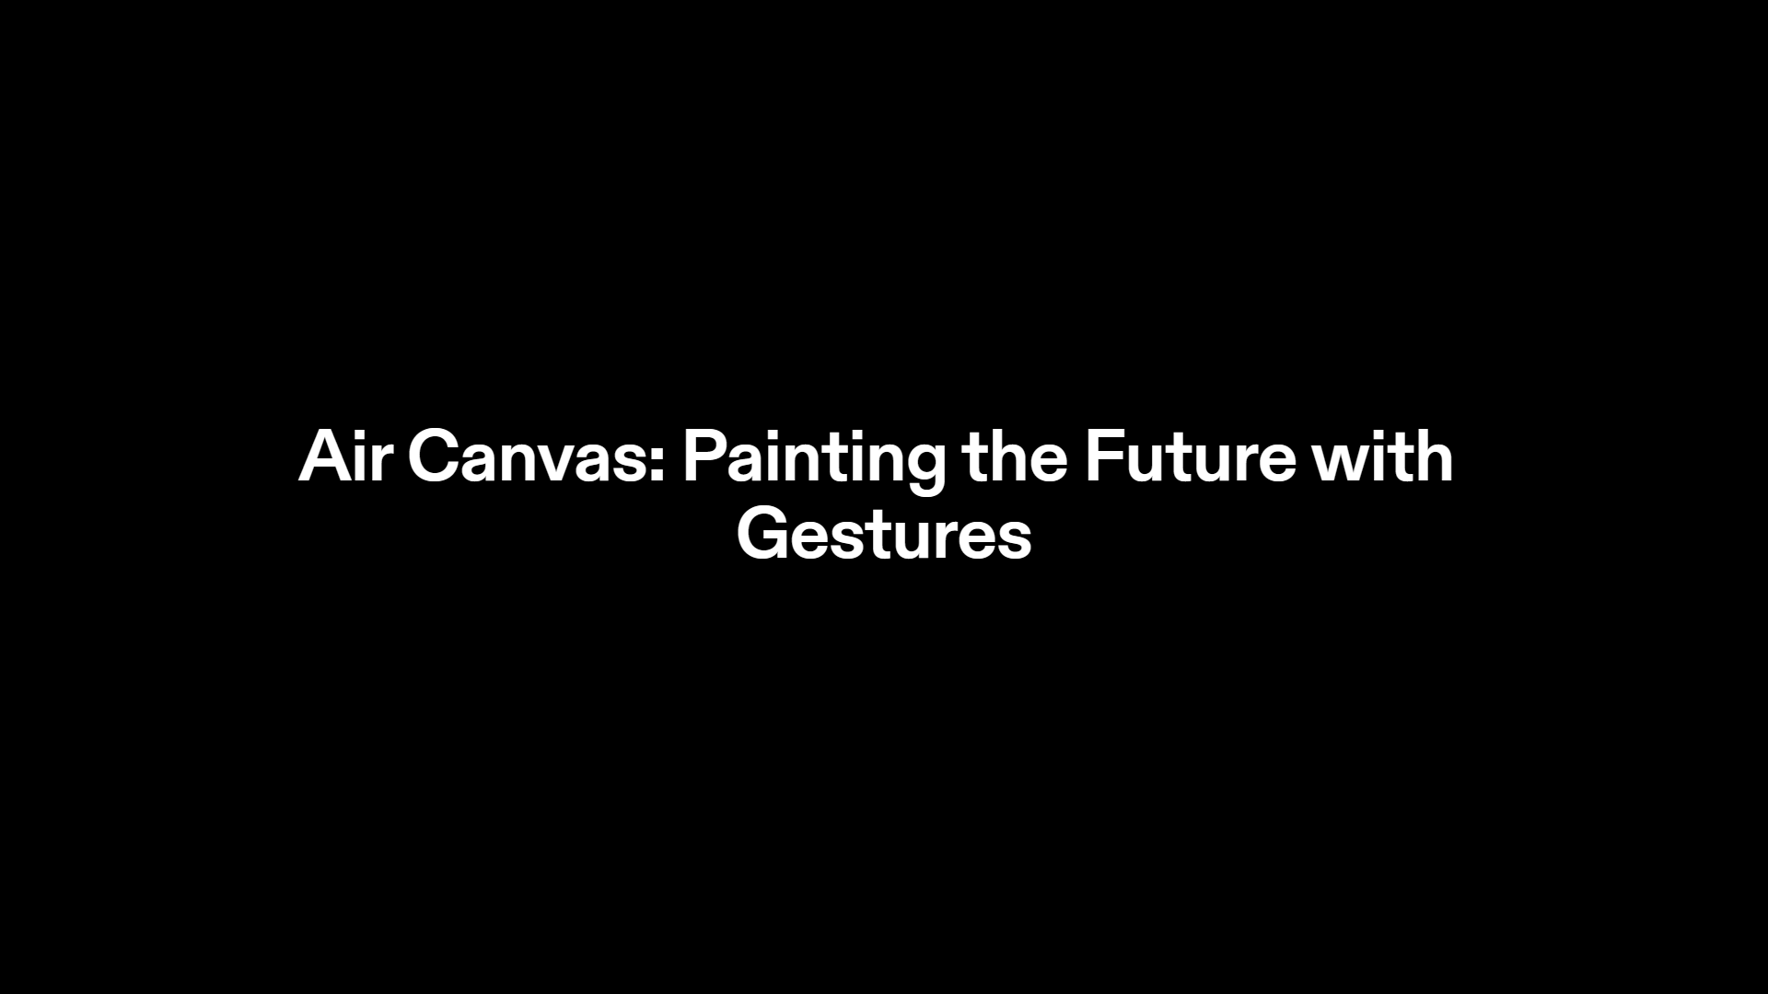

Slide 2


Slide 3
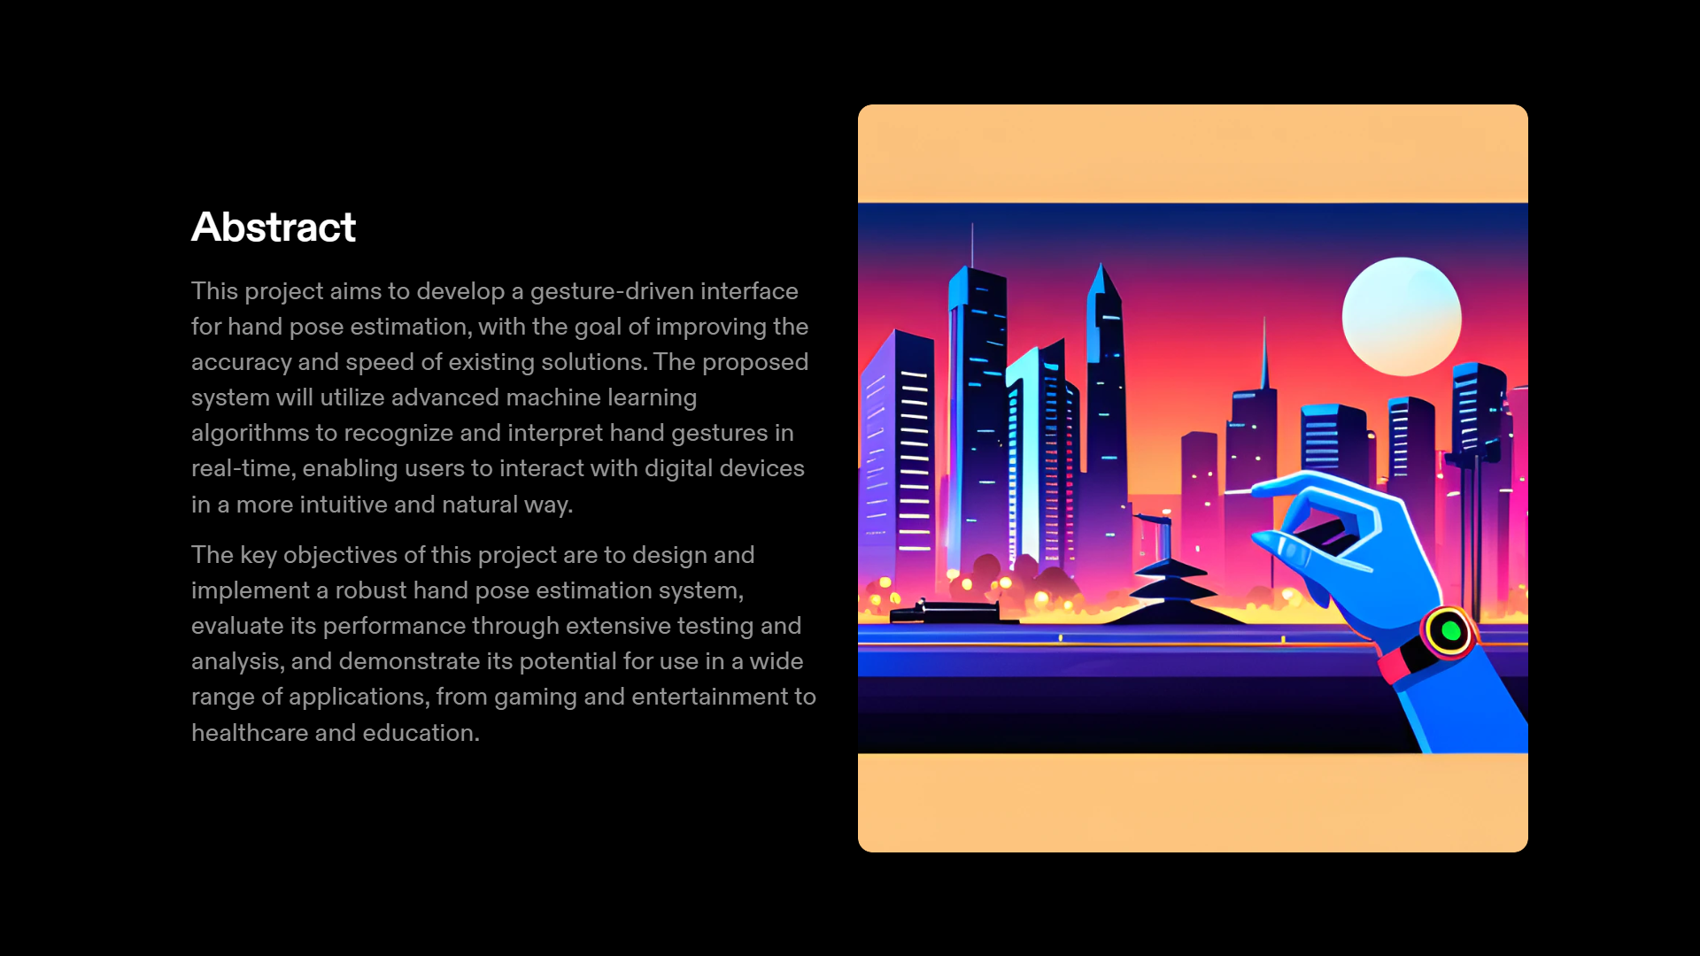

Slide 4
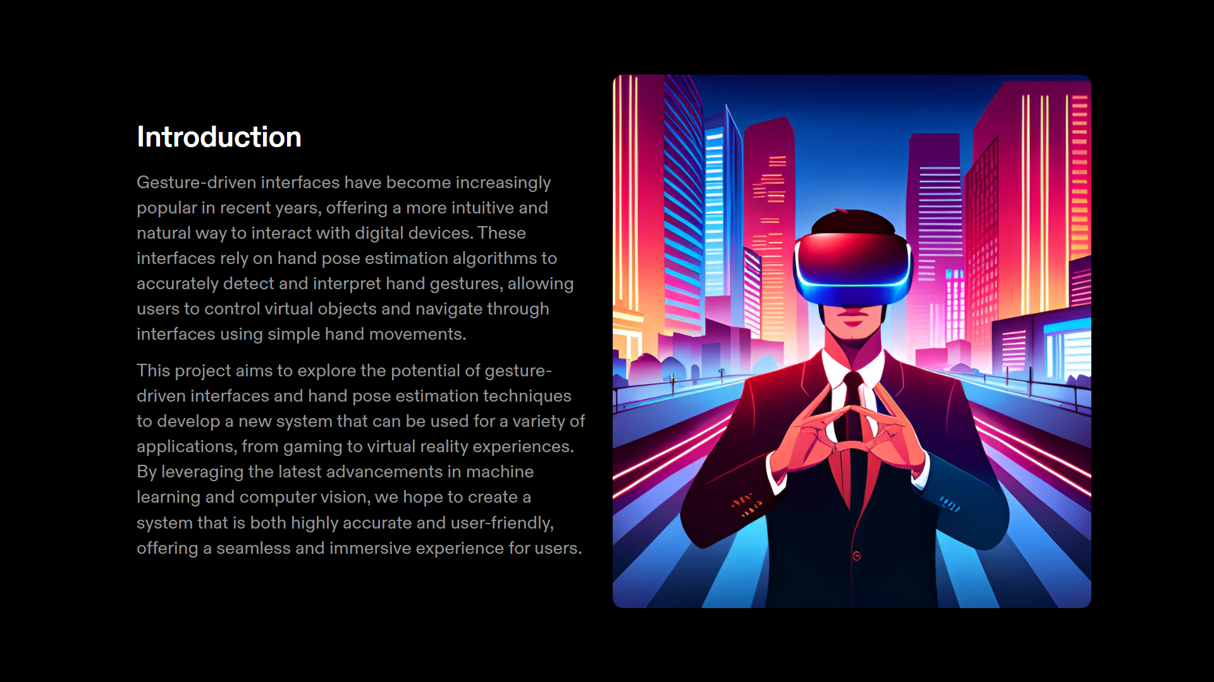
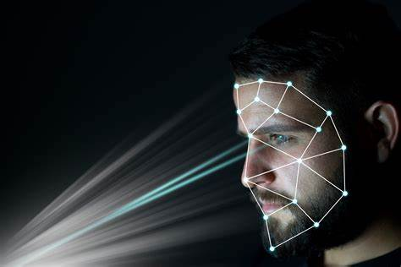

Slide 5
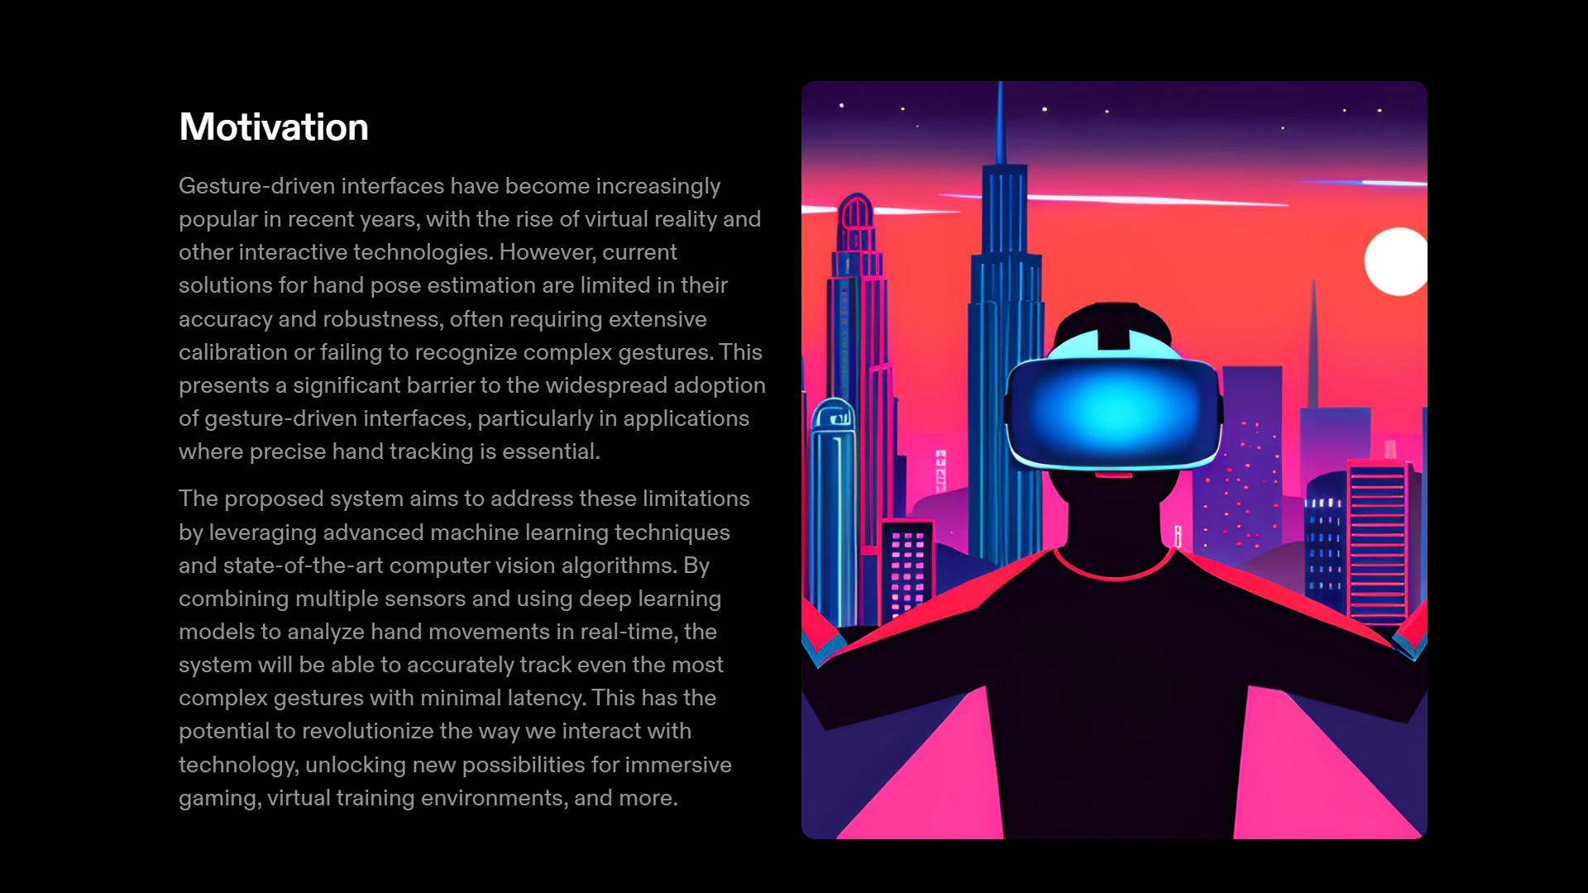


Slide 6
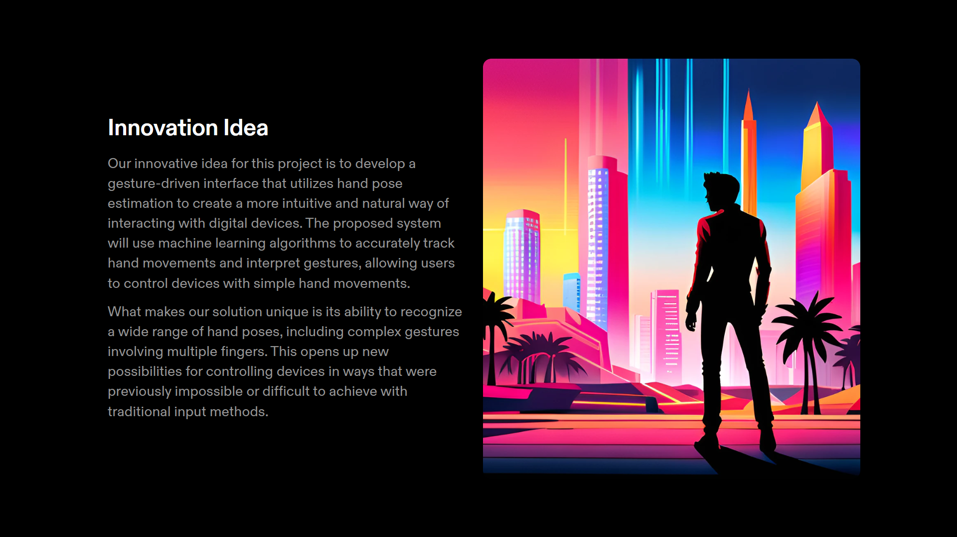


Slide 7
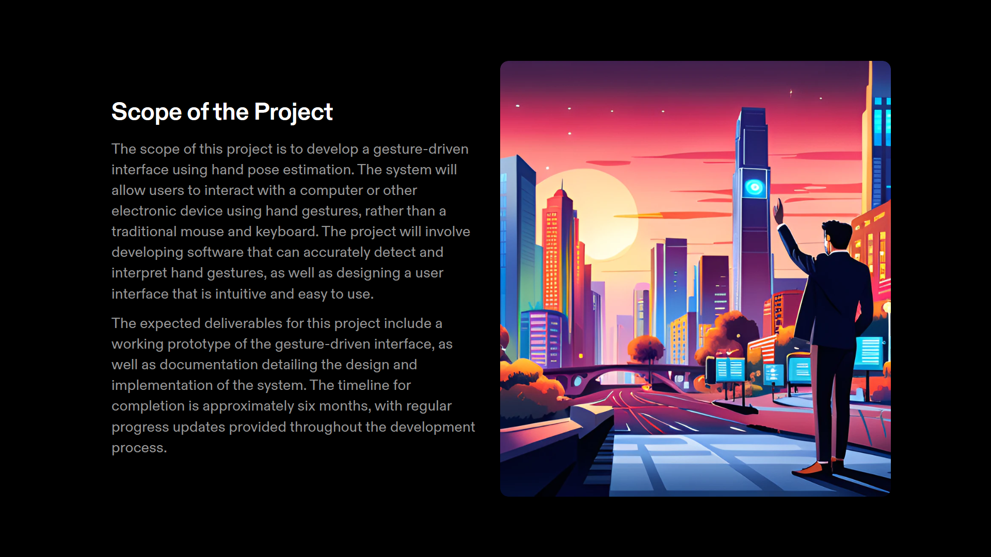
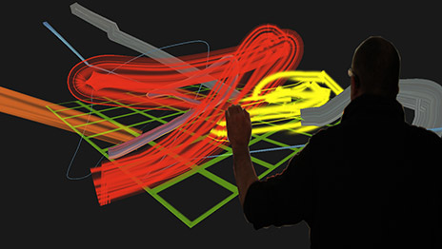

Slide 8
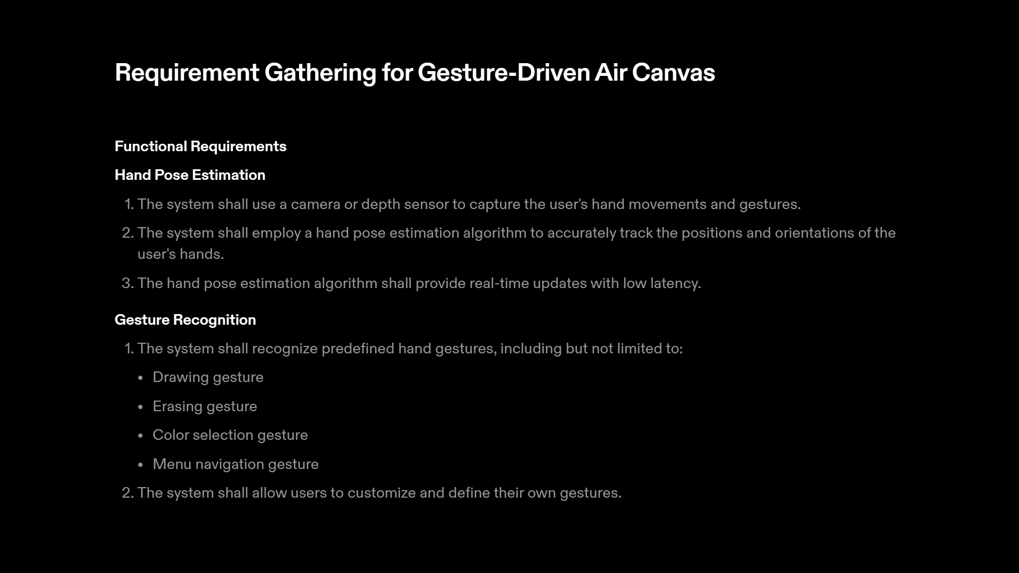

Slide 9
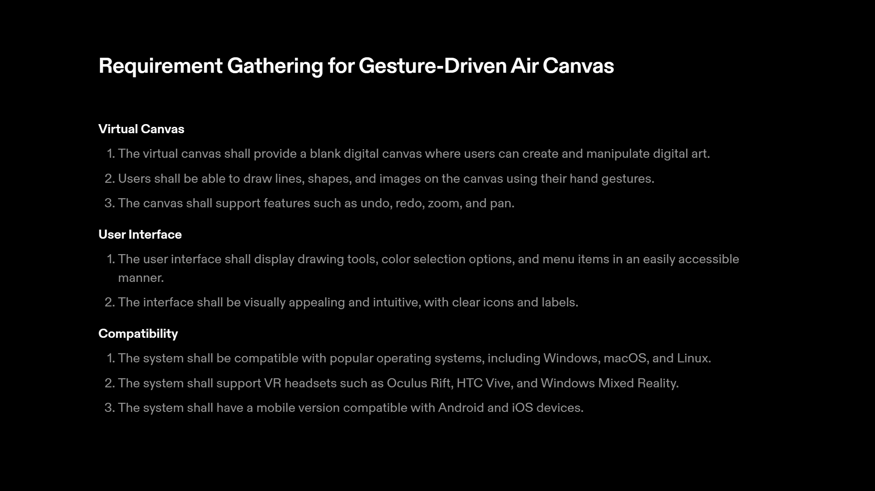

Slide 10
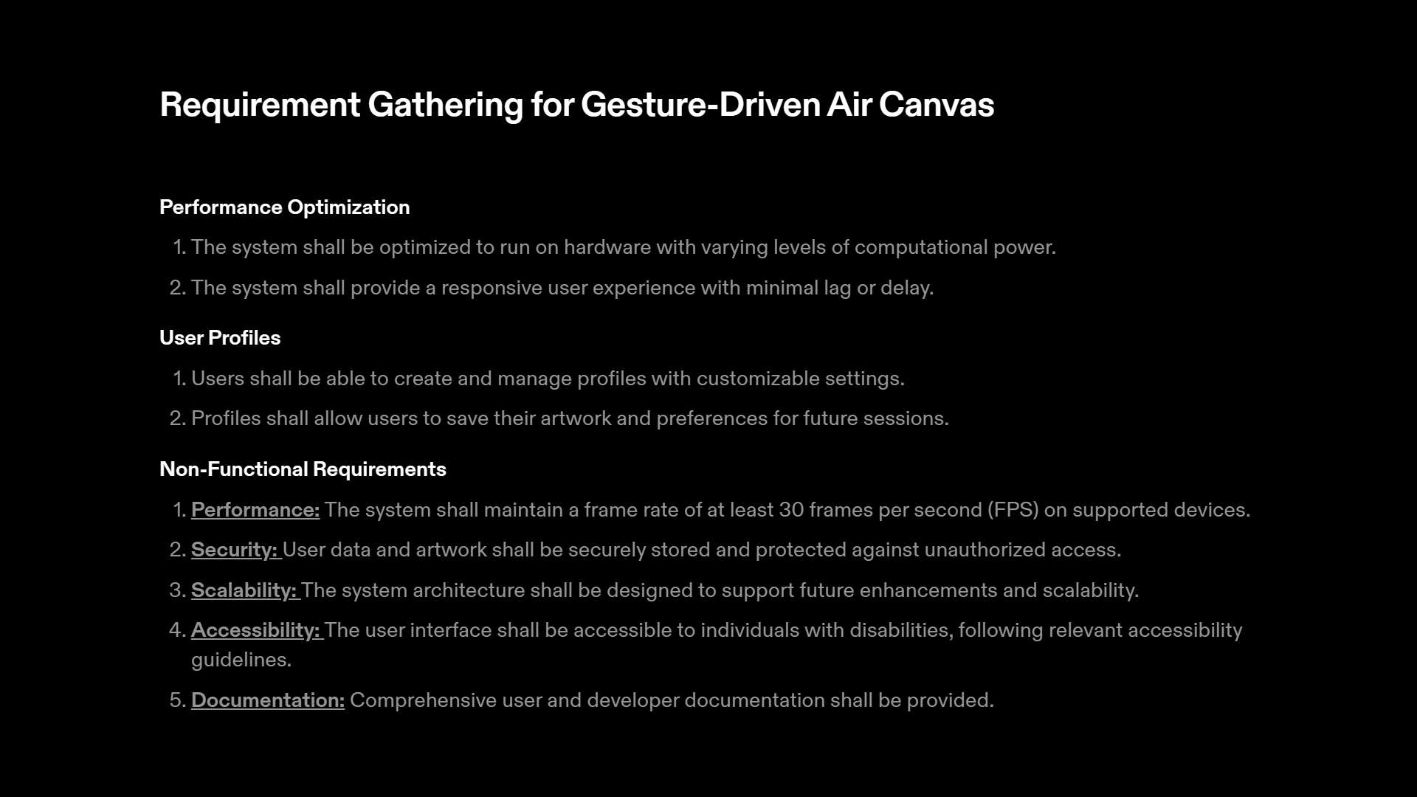

Slide 11
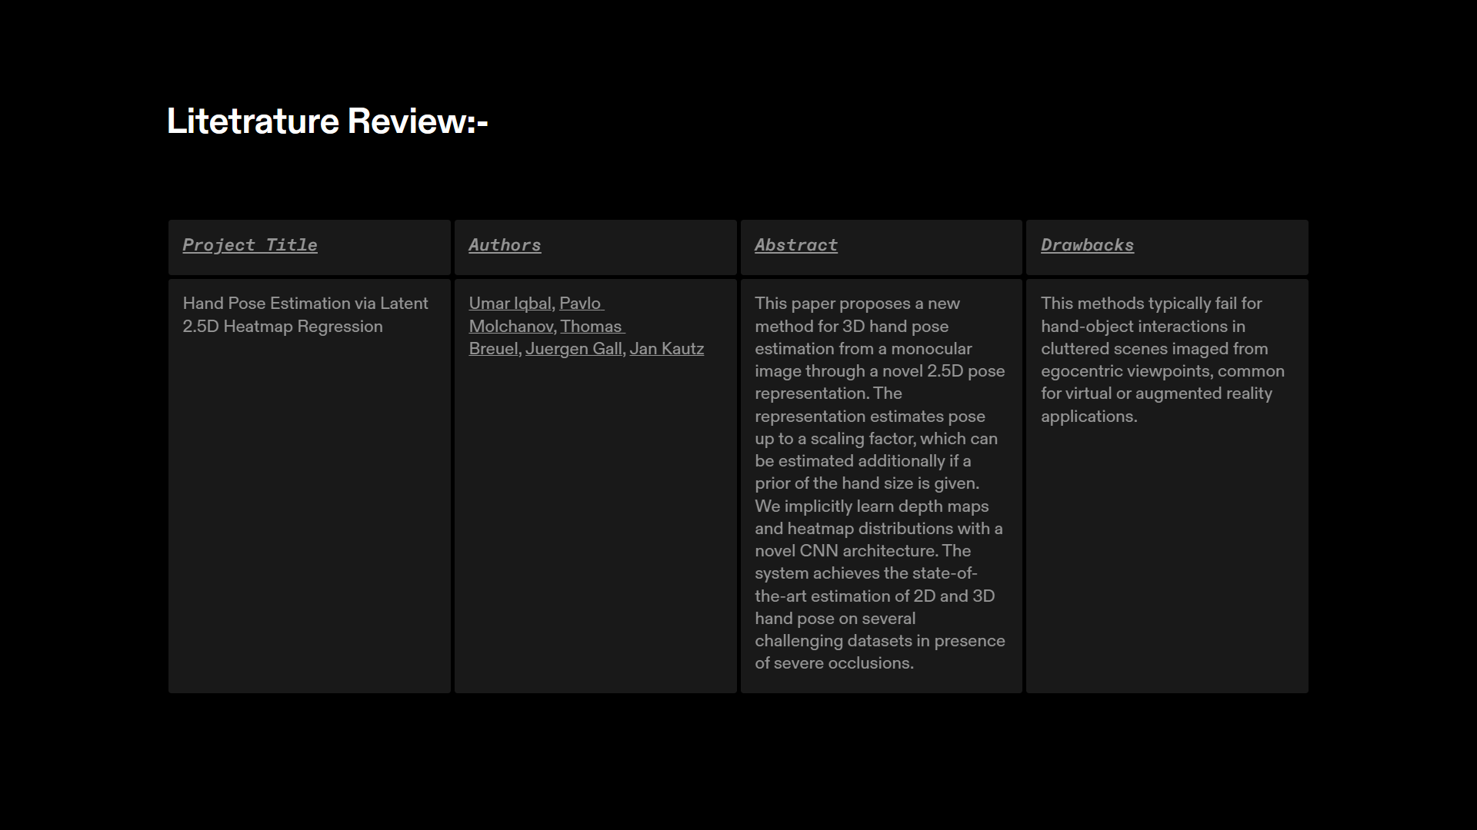
https://docs.google.com/spreadsheets/d/1yVCGmOho_0nv7M2PGv8Daib_zit8Ghzz/edit#gid=896660190

Slide 12
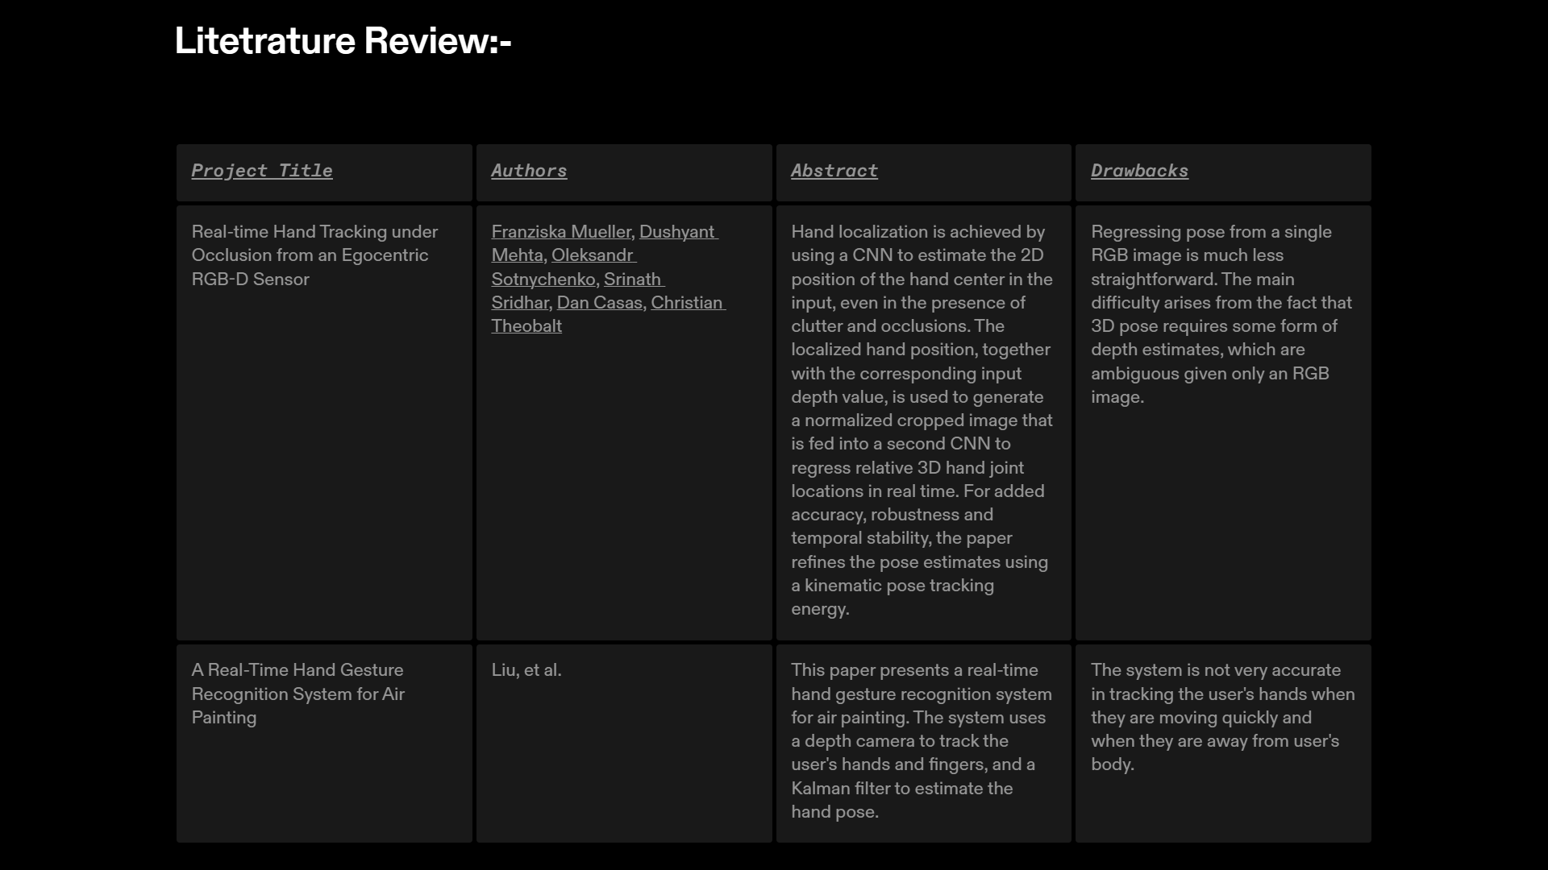

Slide 13
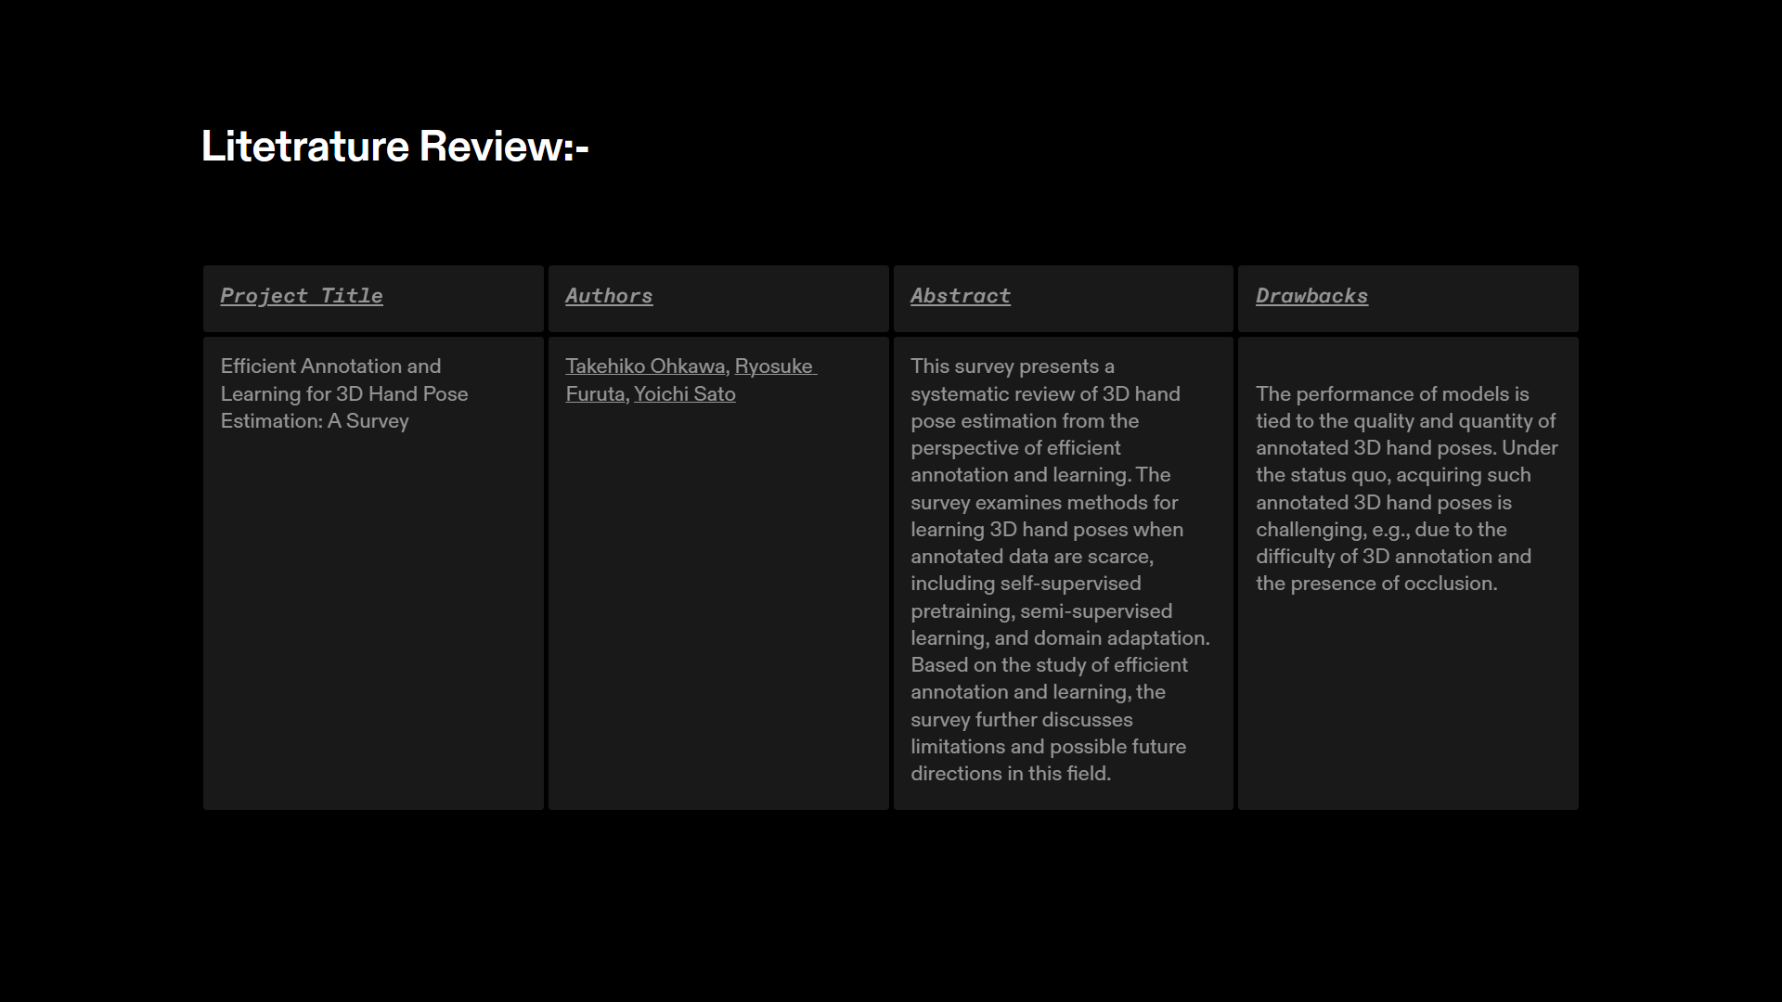
https://docs.google.com/spreadsheets/d/1yVCGmOho_0nv7M2PGv8Daib_zit8Ghzz/edit#gid=896660190

Slide 14
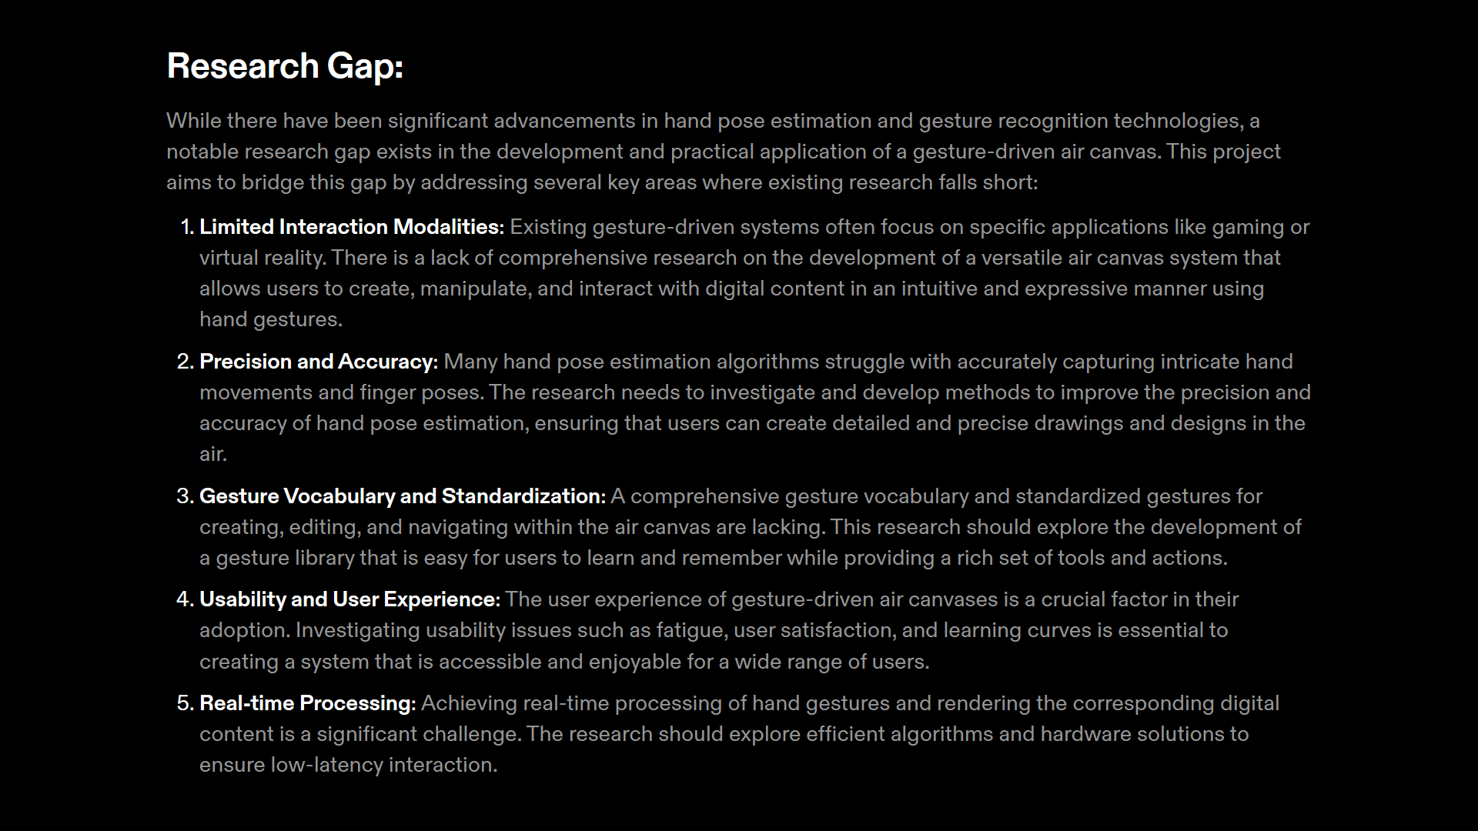

Slide 15
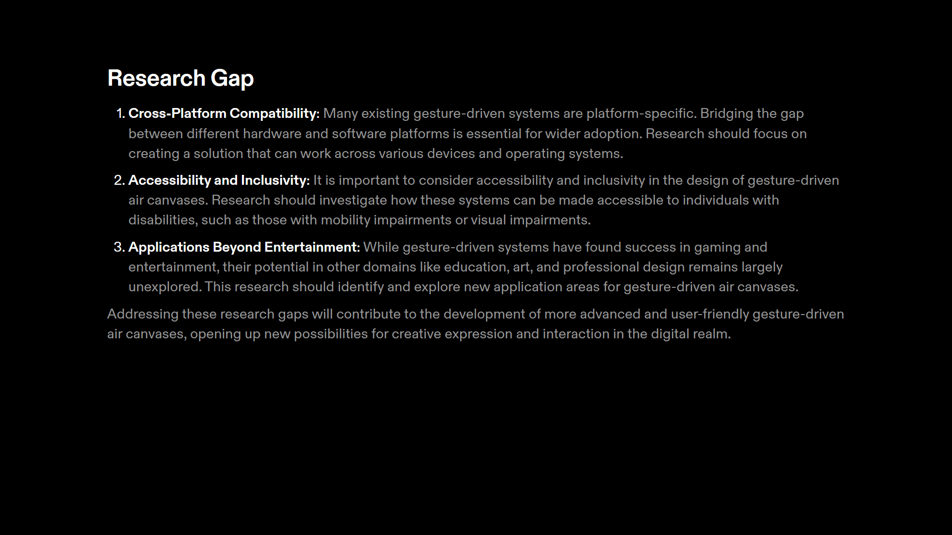

Slide 16
OBJECTIVE
Create an Intuitive Digital Canvas Interface: Develop an interactive digital canvas that responds to hand gestures, making it intuitive and accessible for a wide range of users, including artists, designers, educators, and professionals.
Enhance Creative Expression: Enable users to express their creativity through natural hand movements, offering a more expressive and immersive digital content creation experience.
Improve Accessibility: Lower barriers to entry for digital content creation by providing a touchless and intuitive interface, benefiting users with physical limitations and novice users.
Foster Collaboration: Facilitate collaborative creativity by allowing multiple users to interact with the same canvas simultaneously, fostering teamwork and innovation.
Advance Gesture Recognition: Achieve high levels of accuracy and responsiveness in gesture recognition, allowing for the precise interpretation of a wide range of gestures and movements.
Support Multiple Platforms: Ensure compatibility with various devices and platforms, including desktop computers, mobile devices, and virtual reality (VR) headsets.
Expand 3D and VR Integration: Incorporate 3D modeling capabilities and extend integration with VR devices to enable users to create and interact with 3D digital content.
Incorporate AI Enhancements: Integrate artificial intelligence to offer features like style transfer, gesture prediction, and auto-correction to assist users in their creative process.
Promote Emotional Expression: Implement emotion-sensing technology to adapt the canvas based on the user's emotional state, providing a unique and emotionally engaging experience.
Educational Enhancement: Provide tools for educators to create interactive, immersive, and engaging learning experiences, particularly in art and science education.
Streamline Professional Workflows: Enhance the efficiency and productivity of professionals in fields like design, architecture, and prototyping by enabling rapid digital content creation and manipulation.
Ensure Data Privacy and Security: Implement robust data protection measures and ensure user privacy and security, particularly in collaborative settings.
Cross-Platform Compatibility: Guarantee seamless integration with various operating systems and devices, allowing users to access and interact with the canvas wherever and however they choose.

Slide 17
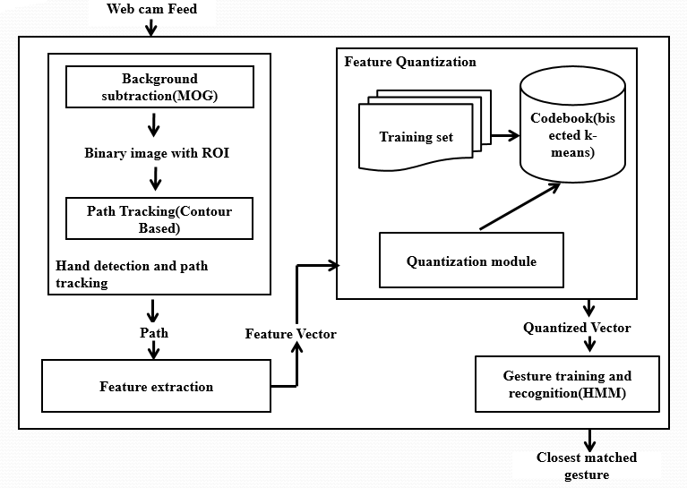
ARCHITECTURE DIAGRAM

Slide 18
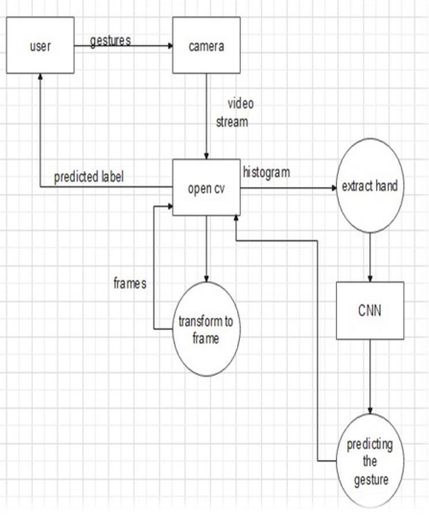
FLOW DIAGRAM
Drawing on Air Canvas

Slide 19
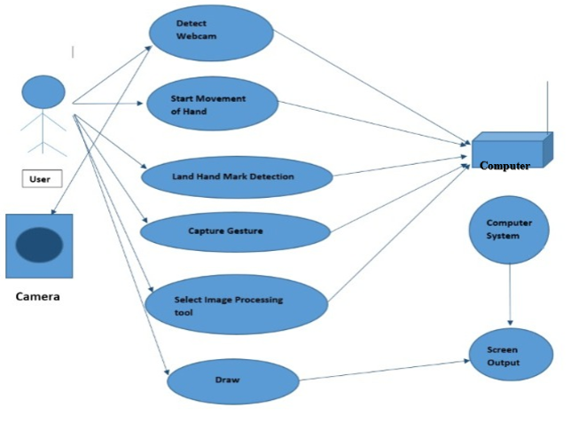
USE CASE DIAGRAM

Slide 20
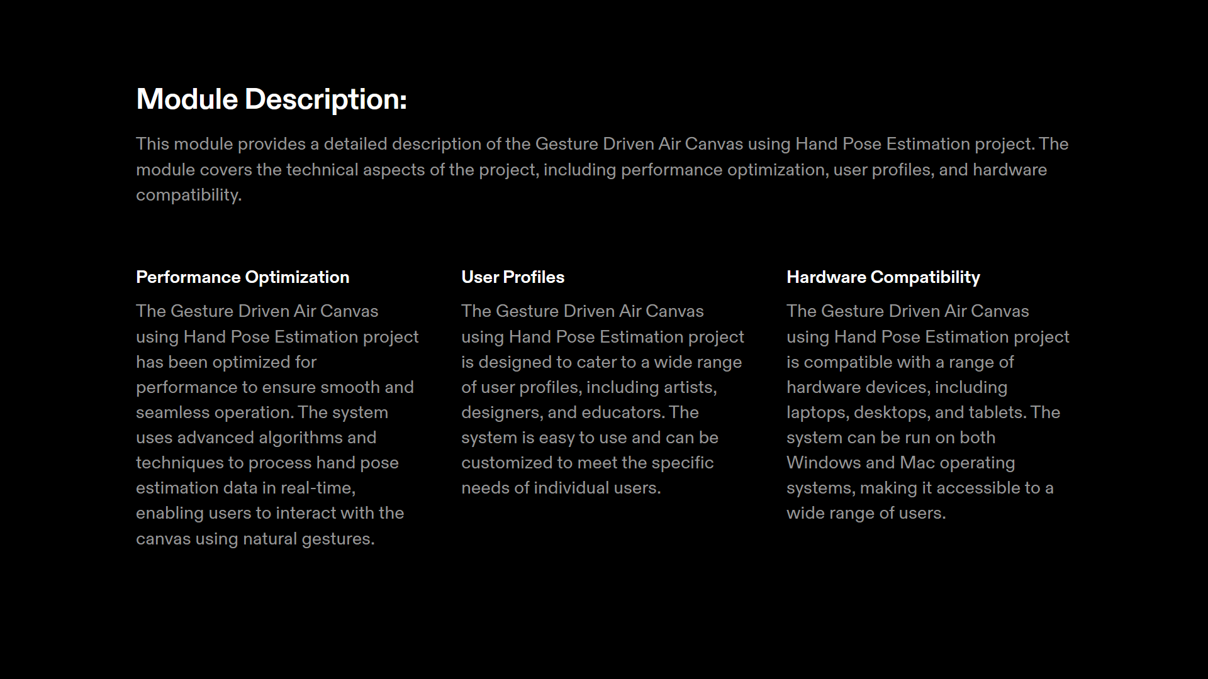

Slide 21
MODULE DESCRIPTION
Air Canvas: This could imply a digital canvas or interface that is manipulated in the air, without the need for physical touch or a stylus. It might be a virtual environment where users can draw, write, or interact with digital content using hand gestures. This could be implemented using technologies like motion sensors, augmented reality (AR), or virtual reality (VR) systems.
Hand Gesture: Hand gestures refer to the use of specific movements or positions of the hands to interact with digital or physical objects. In the context of an "Air Canvas," hand gestures might be used to draw, erase, select, or perform other actions within the digital canvas. This would require sophisticated motion tracking and gesture recognition technology.
The specific modules or components of the air canvas include:
Motion Sensors: These sensors, such as cameras, can capture the movements and positions of a user's hands in the air.
Gesture Recognition Software: This software processes the data from the motion sensors to interpret hand gestures. It identifies specific gestures and maps them to commands or actions within the air canvas.
Virtual or Augmented Reality Display: To provide a visual representation of the air canvas and enable the user to see the results of their gestures. This could be a head-mounted display or a screen.
Interactive Software: The software or application that enables users to draw, write, or interact with the virtual canvas. It receives input from the gesture recognition system and displays the results on the virtual canvas.
User Interface: This is what the user interacts with, and it could include virtual tools like pens, brushes, erasers, color palettes, and other options for creating or editing content.
Feedback Mechanism: Providing haptic feedback, sounds, or visual cues to let the user know that their gestures have been recognized and actions have been performed.

Slide 22
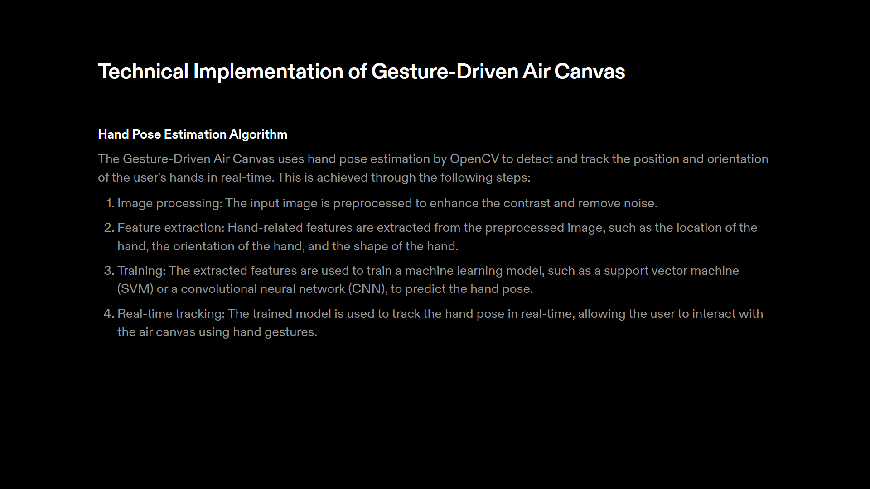

Slide 23
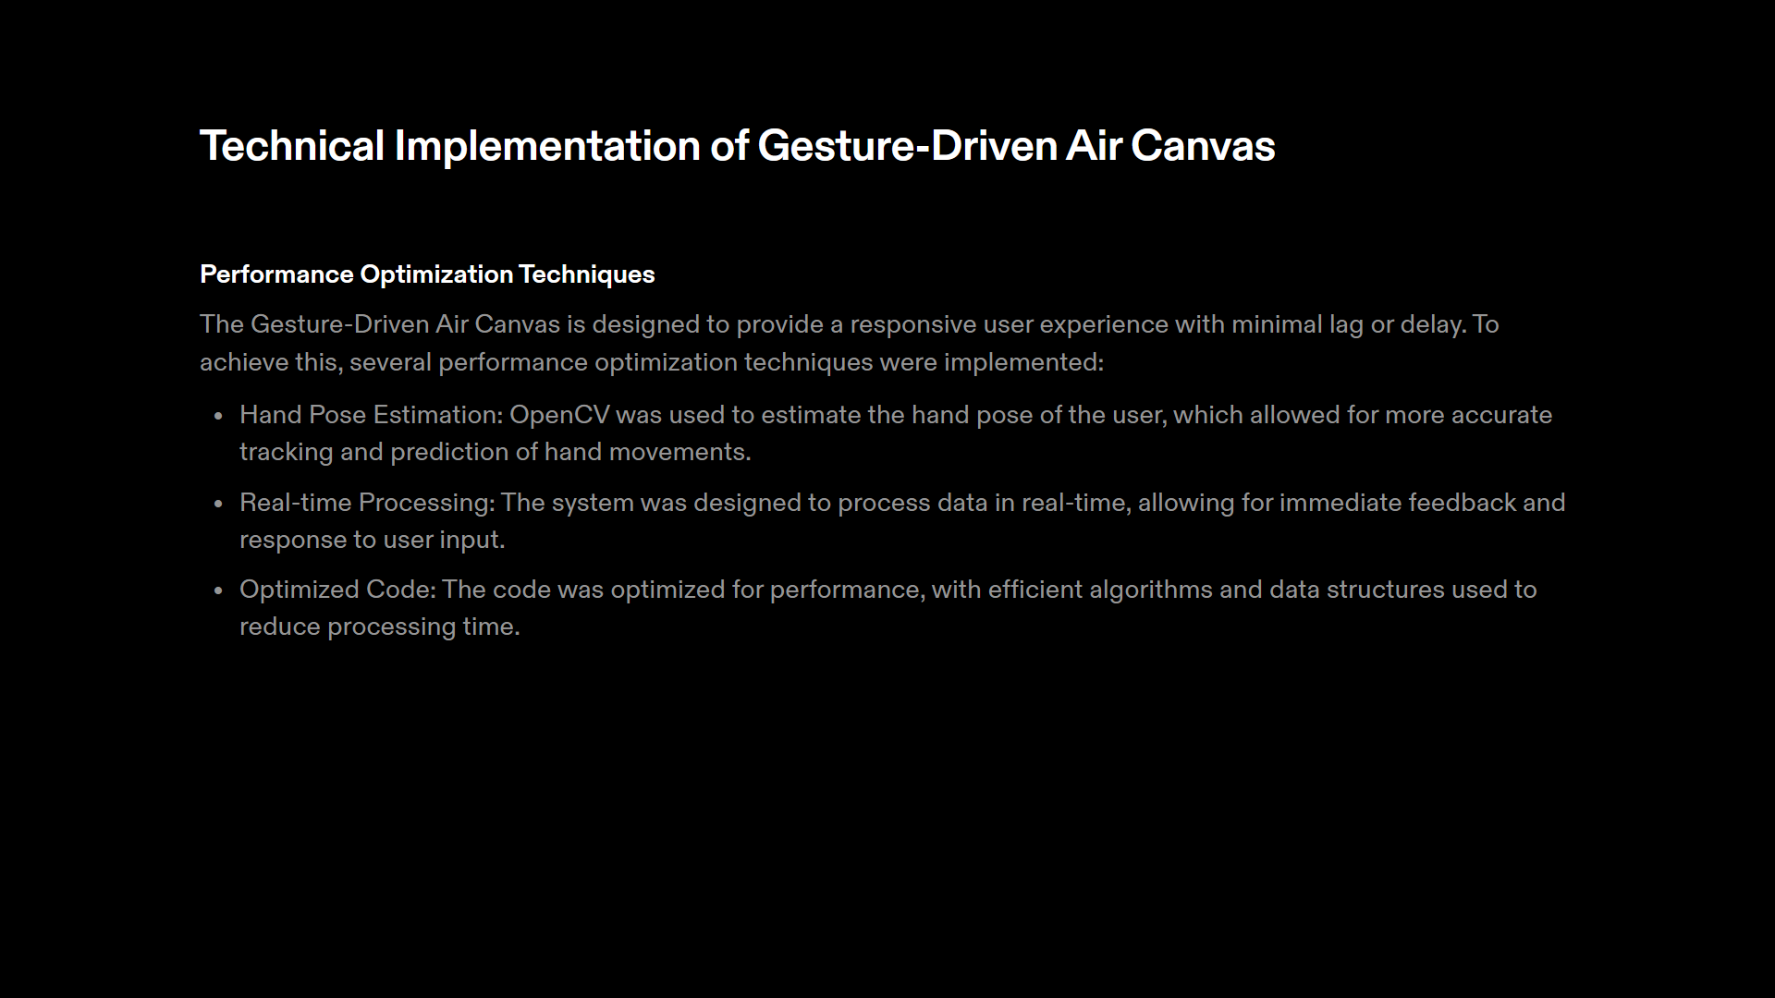

Slide 24
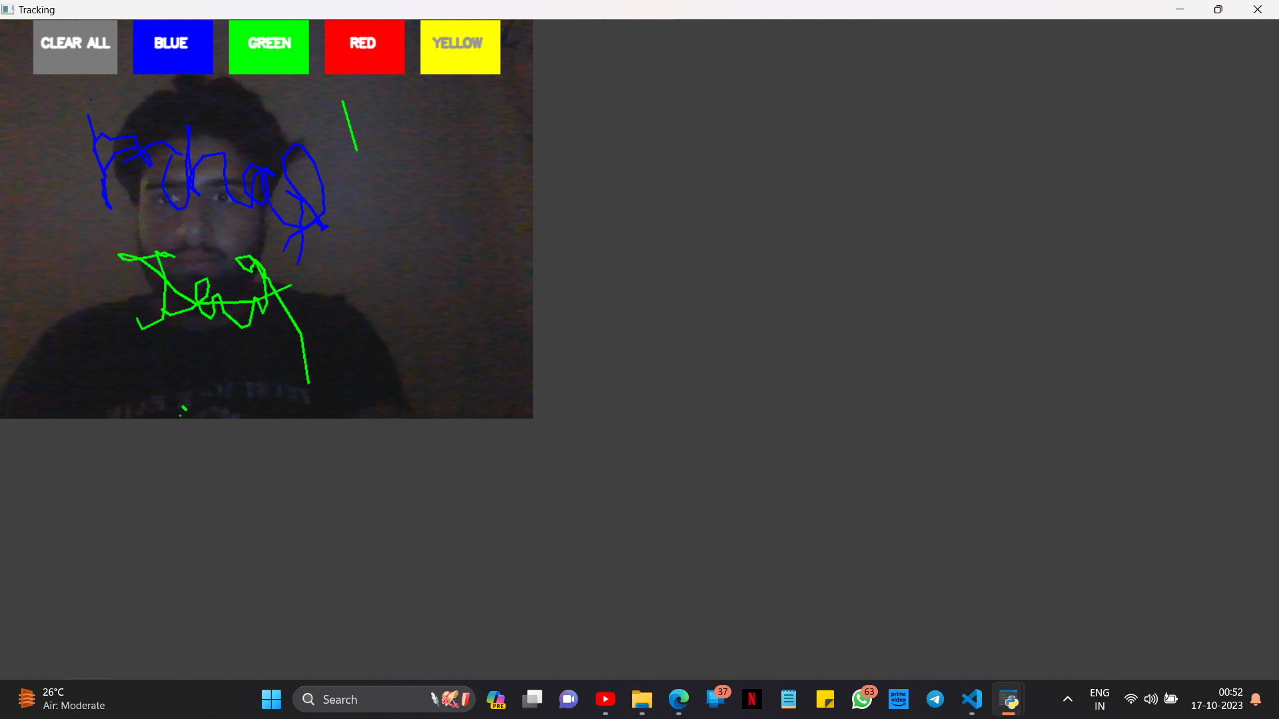
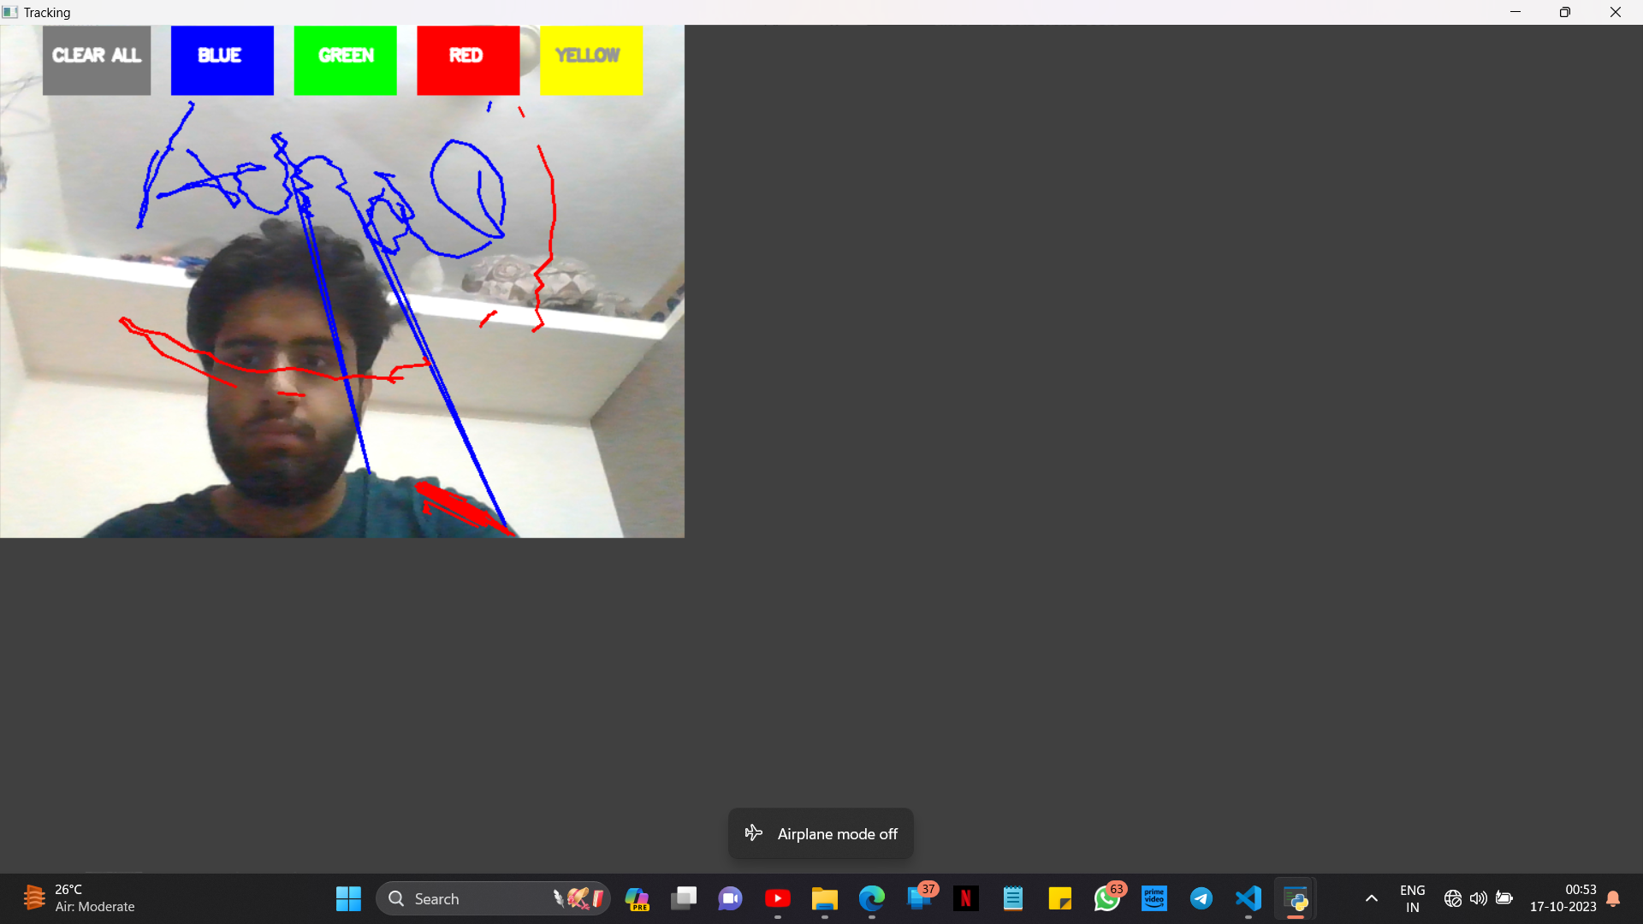
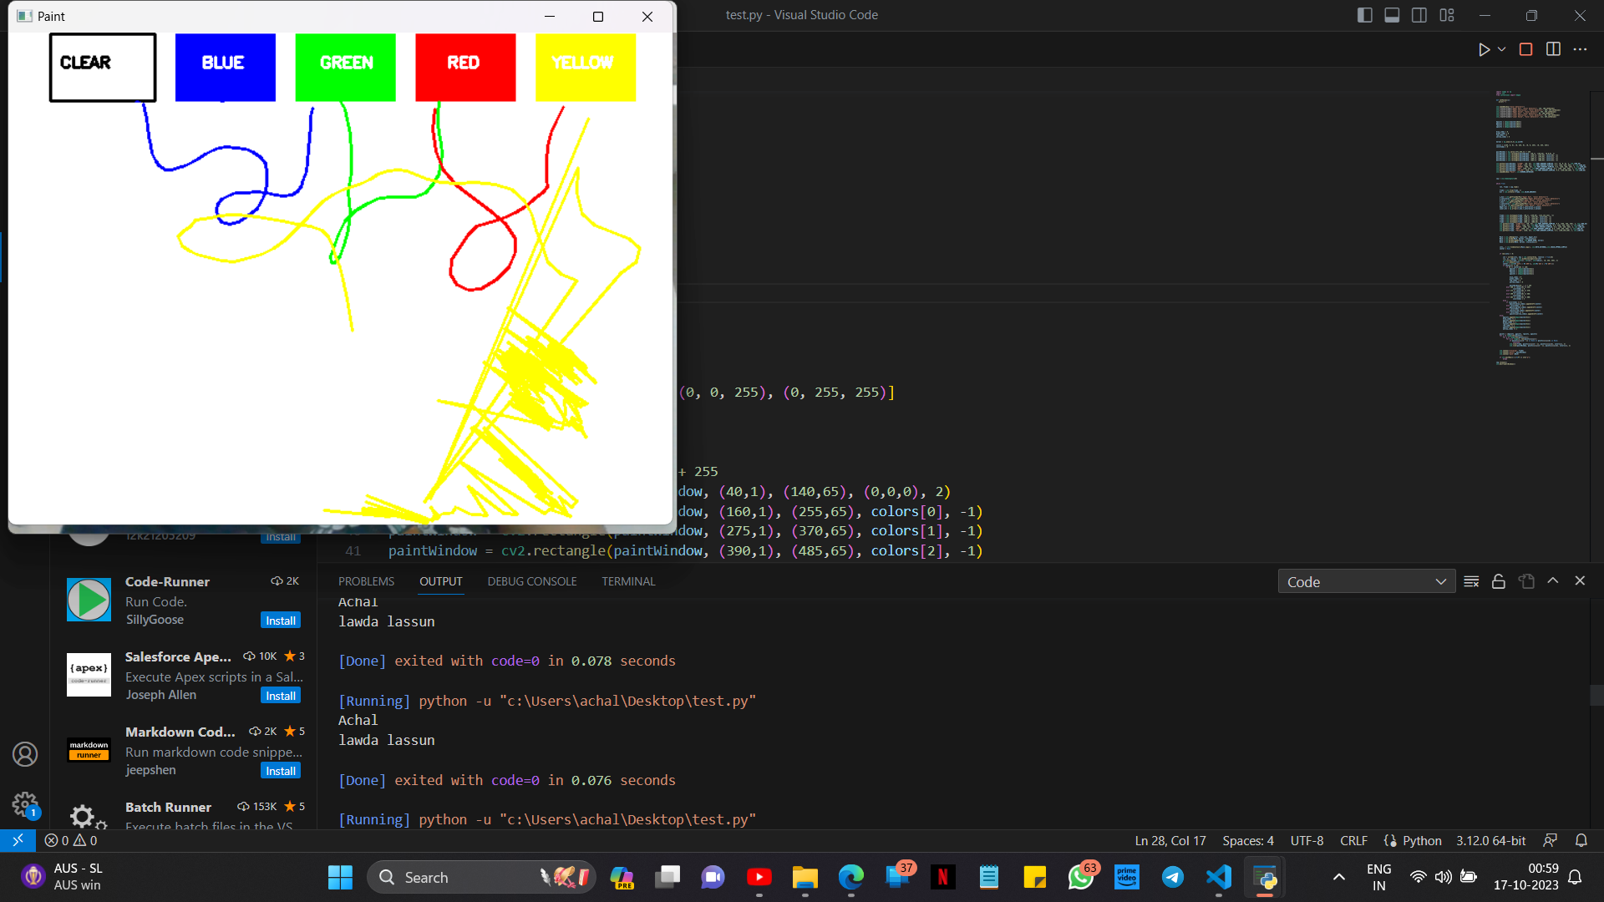

OUTPUT

Slide 25
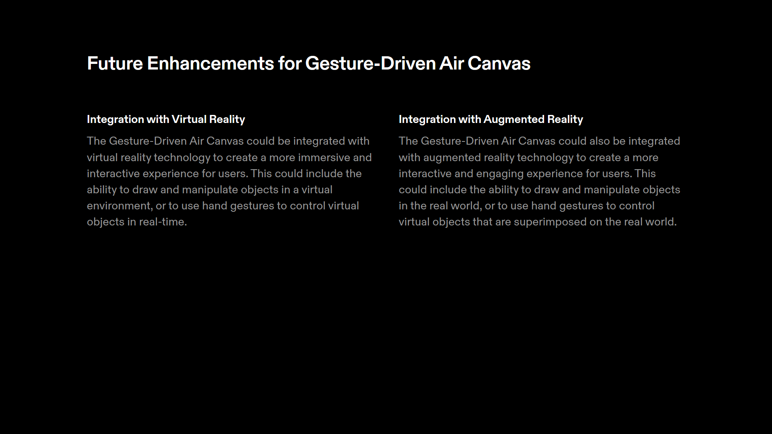

Slide 26
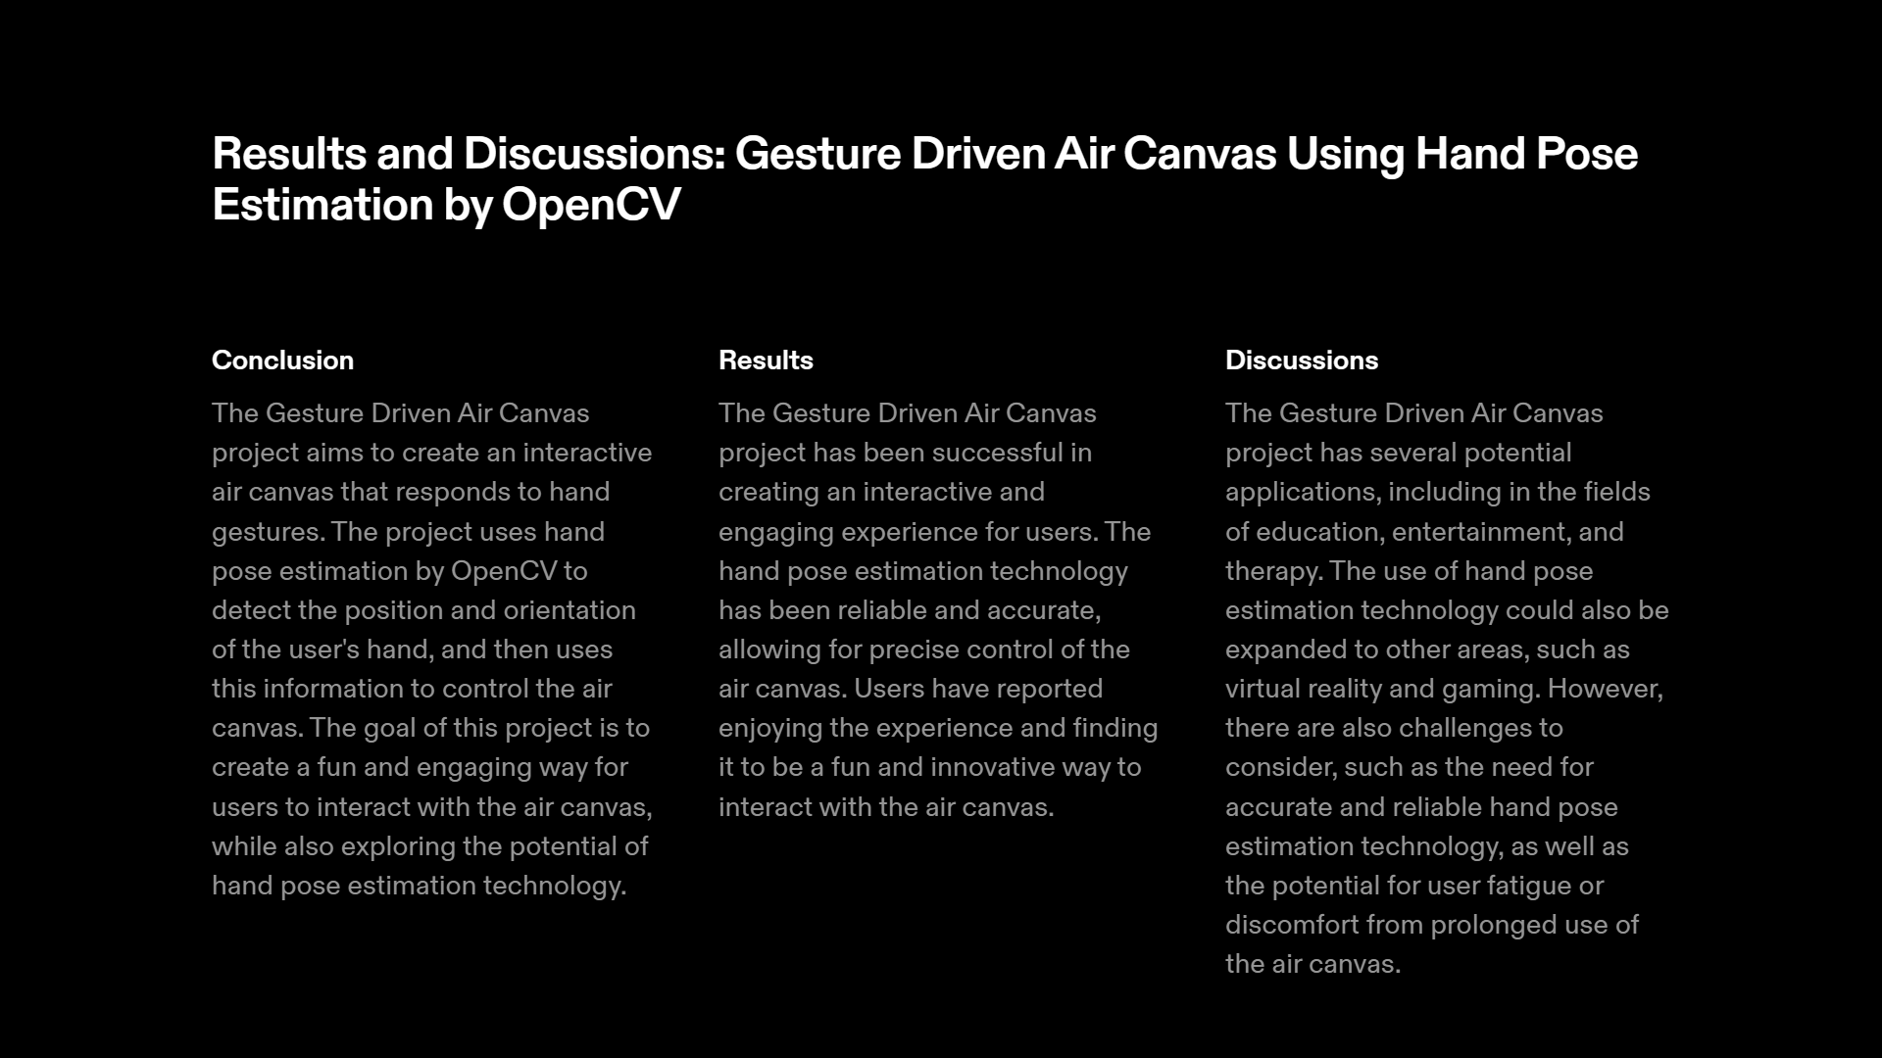

Slide 27
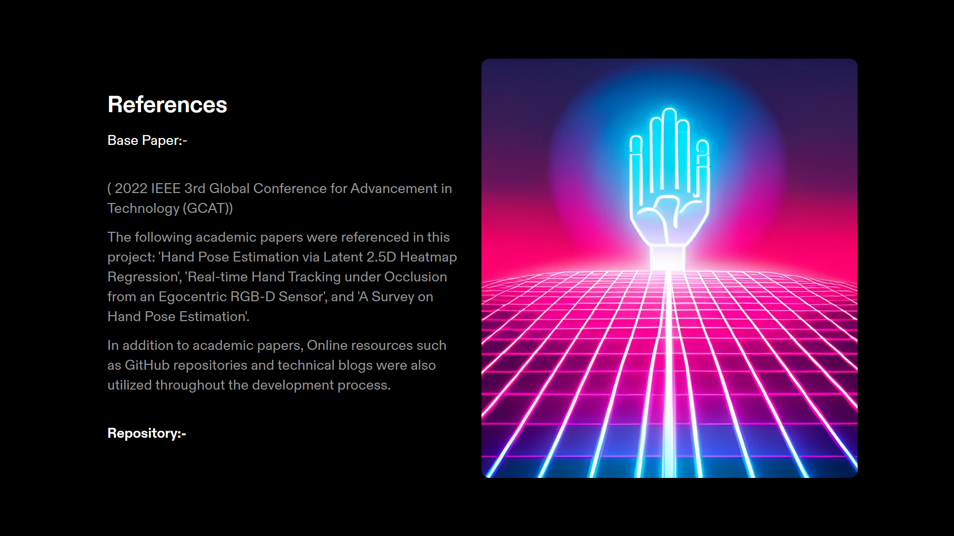
Hierarchical topology based hand pose estimation from a single depth image | SpringerLink
https://ieeexplore.ieee.org/document/9971903
https://github.com/topics/3d-hand-pose-estimation

